Slide 1
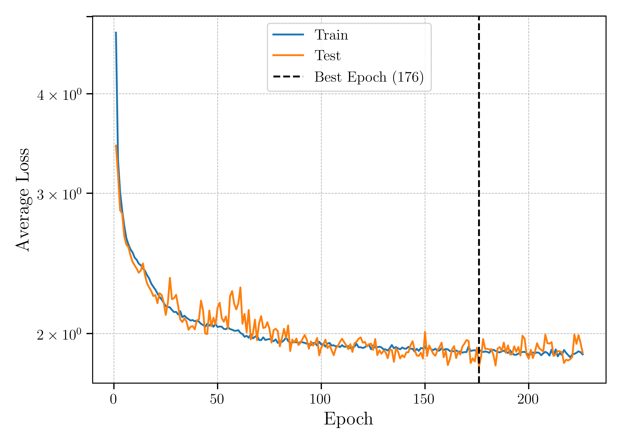
Input (18)
Host SED
ReLU (18)
Legend
ReLU (15)
ReLU (12)
Input/Output
ReLU (9)
Hidden Layer
ReLU (6)
Physical Value
ReLU (4)
Linear (4)
Linear (4)
Host Properties
Linear (3)
(a)
(b)

Slide 2
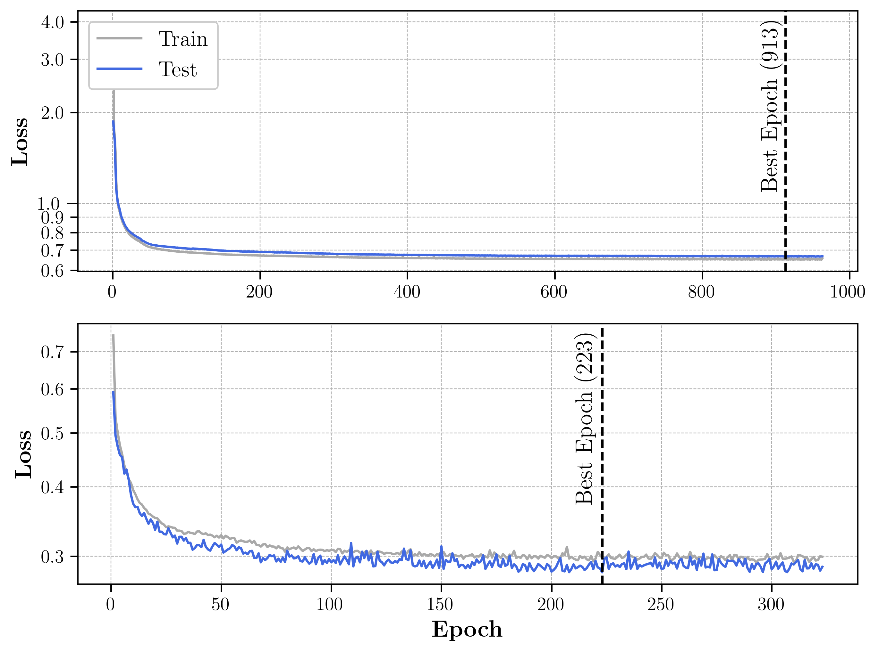
Legend
Host SED
Physical Value
Hidden Layer
Input (18)
ReLU (18)
Input/Output Layer
ReLU (15)
Host grizy
ReLU (12)
Input (5)
ReLU (9)
(c)
ReLU (7)
ReLU (6)
ReLU (9)
ReLU (4)
ReLU (11)
Linear (4)
ReLU (13)
Linear (4)
Linear (13)
Linear (3)
Host SED
Host Properties
(a)
(b)
(d)

Slide 3
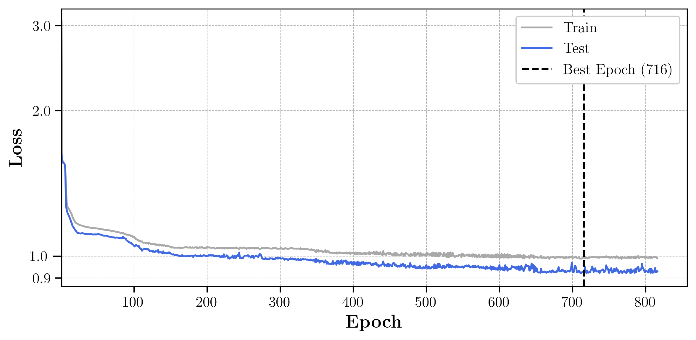
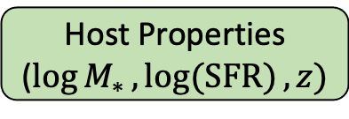
Host grizy
Host Redshift
Input (6)
Legend
ReLU (6)
Physical Value
ReLU (5)
Hidden Layer
ReLU (4)
Input/Output Layer
ReLU (3)
Linear (3)
(a)
Host Properties
($\log{M_{∗}},\log{(SFR)}, z)$
(b)

Slide 4
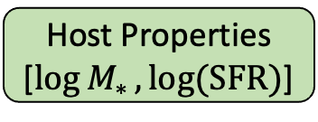
Host Redshift
Host grizy
Legend
Input (6)
Physical Value
ReLU (6)
Hidden Layer
ReLU (5)
Input/Output Layer
ReLU (4)
ReLU (3)
Linear (3)
Host Properties
[$\log{M_{∗}},\log{(SFR)}$]

Slide 5
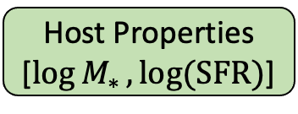
Host grizy
Host Redshift
Legend
Input (6)
Physical Value
ReLU (6)
Hidden Layer
ReLU (5)
Input/Output Layer
ReLU (4)
ReLU (3)
Linear (3)
Linear (2)
Host Properties
[$\log{M_{∗}},\log{(SFR)}$]

